Slide 1
SICK Cockpit Manager App
User
CM Frontend
Ionic
AngularJS
-Cordova
Chart.js
Websockets
.NetCore Kestrel Webserver
CM Backend (API)
C#
.NetCore

Slide 2
build/compile
TypeScript
(Angular)
JS
main.js
Browser
TypeScript
(Angular)
JS
Ionic custom elements
html

Slide 3
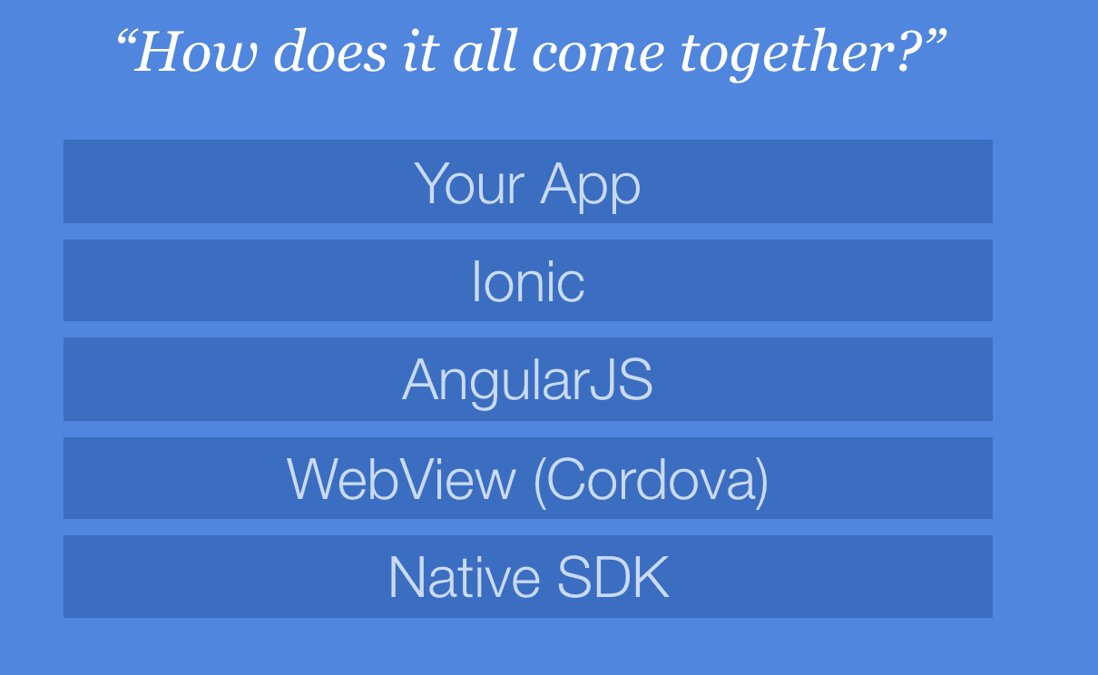

Slide 4
(Functional) Reactive Programming
Notes:
https://gist.github.com/staltz/868e7e9bc2a7b8c1f754

